Slide 1



Analysis of Technology Trends Using IBM Cognos Dashboard
Kevin H.
05.08.2024

Slide 2


OUTLINE
Executive Summary
Introduction
Methodology
Results
Visualization – Charts
Dashboard
Discussion
Findings & Implications
Conclusion
Appendix

Slide 3

EXECUTIVE SUMMARY
In the rapidly evolving developer sector, staying updated with the shifts in programming languages, databases, platforms, and web frameworks is crucial.
This report employs data analytics to highlight current and anticipated trends across these domains.
Demographic Studies: Analysis was conducted on the demographics of developers.
Data Sources: Information was gathered from the Stack Overflow Developer Survey, IBM site, and Jobs API.
Programming Languages: JavaScript remains the leading programming language both currently and into the next year.
Databases: While MySQL is presently the most used database, PostgreSQL is projected to become the most preferred in the future.
Respondent Demographics: The majority of respondents were male, American, with an average age of 28.

Slide 4

INTRODUCTION
This presentation uses data analytics to identify current and future trends in programming languages, databases, platforms, and web frameworks. Targeted audiences include developers, data professionals, HR managers, and individuals interested in in-demand skills.
Key focus areas:
Current popular technologies
Future sought-after skills
Respondent demographics: location, gender, age, education
The goal is to provide insights into the evolving landscape of tech skills and preferences.

Slide 5

METHODOLOGY
The methodology involved collecting, cleaning, analyzing, and visualizing data to assess trends in the developer sector :
Data Collection: Job location data was obtained using the Jobs API and stored in an Excel file.
Data Extraction: Programming languages and average annual salaries were scraped from the survey.
Data Cleaning and Analysis: Python was used to clean and analyze the data, performing exploratory data analysis to assess correlations.
Visualization: Charts, graphs, and dashboards were created using Python and IBM Cognos.

Slide 6

RESULTS

Slide 7
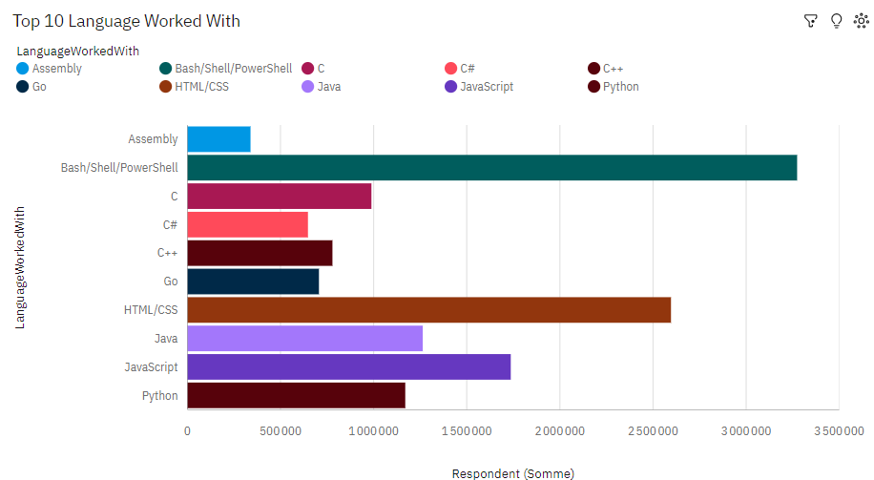
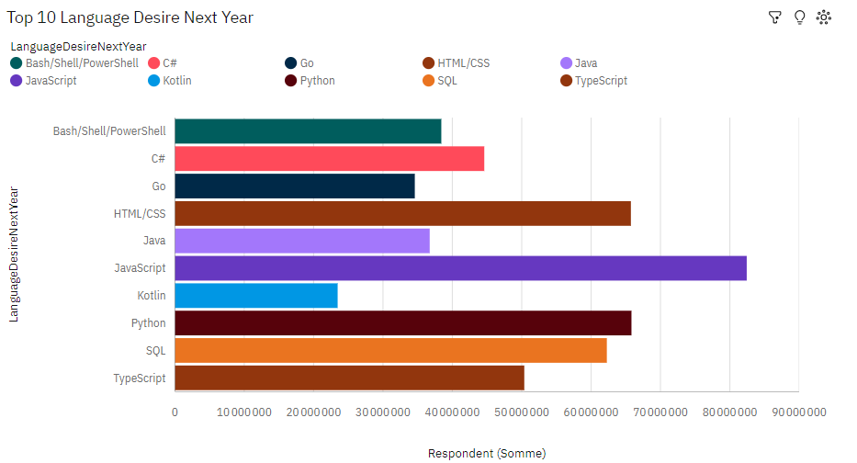
PROGRAMMING LANGUAGE TRENDS
Current Year
Next Year

Slide 8
PROGRAMMING LANGUAGE TRENDS - FINDINGS & IMPLICATIONS
Findings:
JavaScript is the most widely used programming language.
HTML/CSS and SQL are crucial in web development and data management.
Bash/Shell/PowerShell is significant for scripting and automation.
Python is versatile and popular across various domains.
Java continues to be a staple in enterprise and Android development.
Python and JavaScript are highly desired for the future.
Go and TypeScript are gaining interest, indicating a shift towards these languages.
SQL and Kotlin maintain strong future demand
Implications:
Skill Development: Prioritize learning Python and JavaScript; consider Go and TypeScript.
Hiring and Training: Focus on candidates with Python, JavaScript, and SQL skills; offer training in Go and TypeScript.
Technology Adoption: Adopt Go and TypeScript for new projects; ensure proficiency in Bash/Shell/PowerShell.
Educational Focus: Align curricula with these trends, emphasizing Python, JavaScript, Go, and TypeScript.

Slide 9
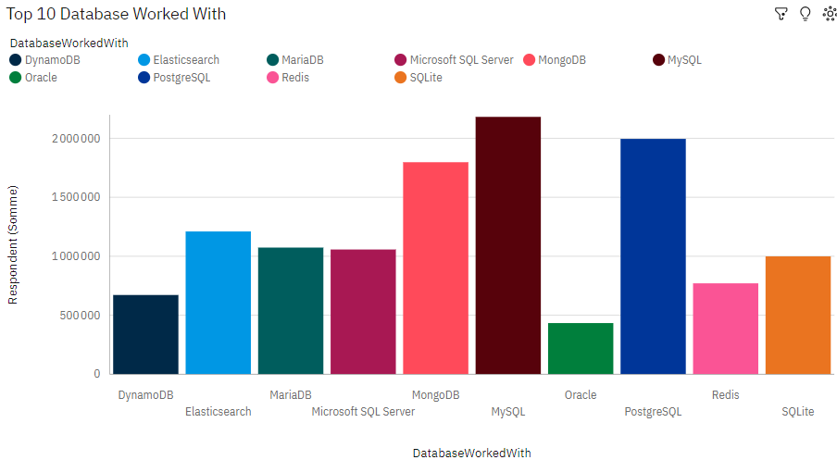
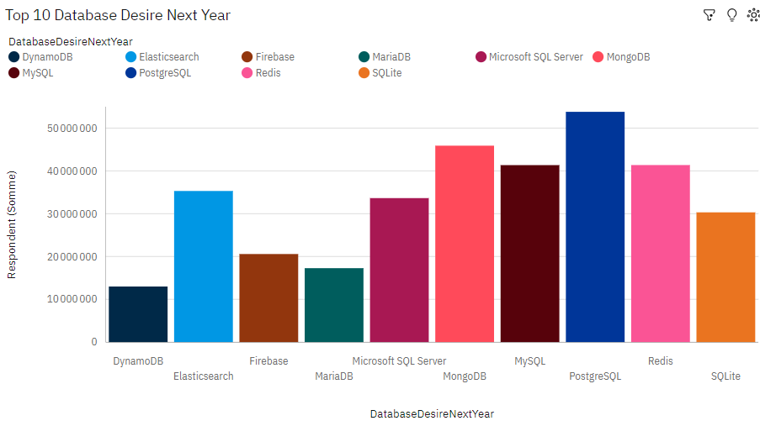
DATABASE TRENDS
Current Year
Next Year

Slide 10
DATABASE TRENDS - FINDINGS & IMPLICATIONS
Findings:
MongoDB is the most widely used database currently.
PostgreSQL is also highly utilized, showing growing popularity.
MySQL remains a major player in database usage.
Elasticsearch and Microsoft SQL Server have significant usage.
Redis is widely used for caching and real-time applications.
PostgreSQL is the most desired database for next year.
MySQL and MongoDB remain highly desired.
Elasticsearch shows strong future interest.
Firebase and Redis have strong future demand.
Implications:
Skill Development: Prioritize learning PostgreSQL; maintain skills in MySQL, MongoDB, and Elasticsearch.
Hiring and Training: Focus on candidates with PostgreSQL, MySQL, and MongoDB skills; offer training in Elasticsearch, Firebase, and Redis.
Technology Adoption: Consider adopting PostgreSQL and Elasticsearch; ensure proficiency in Redis and Firebase.
Educational Focus: Align curricula with trends, emphasizing PostgreSQL, Elasticsearch, Firebase, and Redis.

Slide 11

DASHBOARD
<The GitHub link of the Cognos/Looker Studio dashboard goes here :
https://github.com/blackmamba506/DataAnalystCapstoneDashboard-/blob/main/Capstone%20Dashboard.pdf

Slide 12
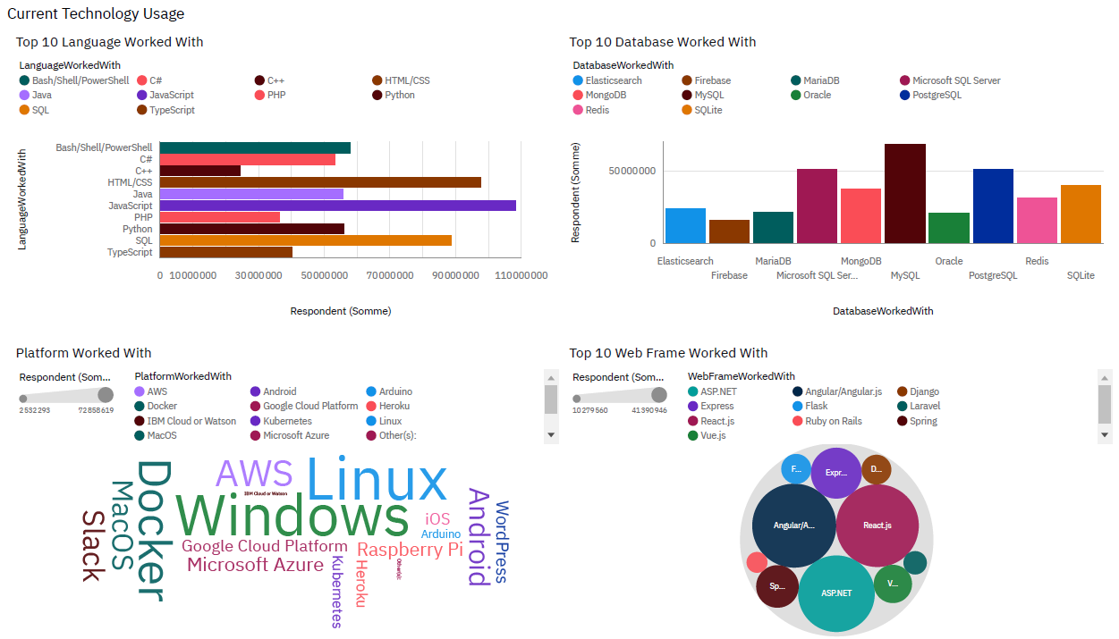
DASHBOARD TAB 1

Slide 13
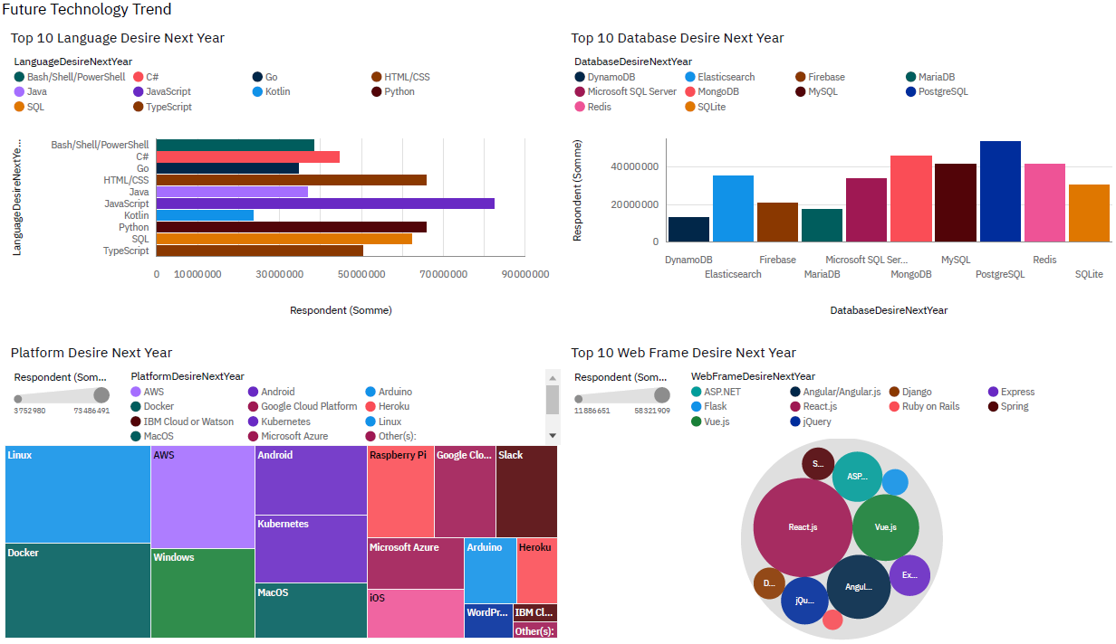
DASHBOARD TAB 2

Slide 14
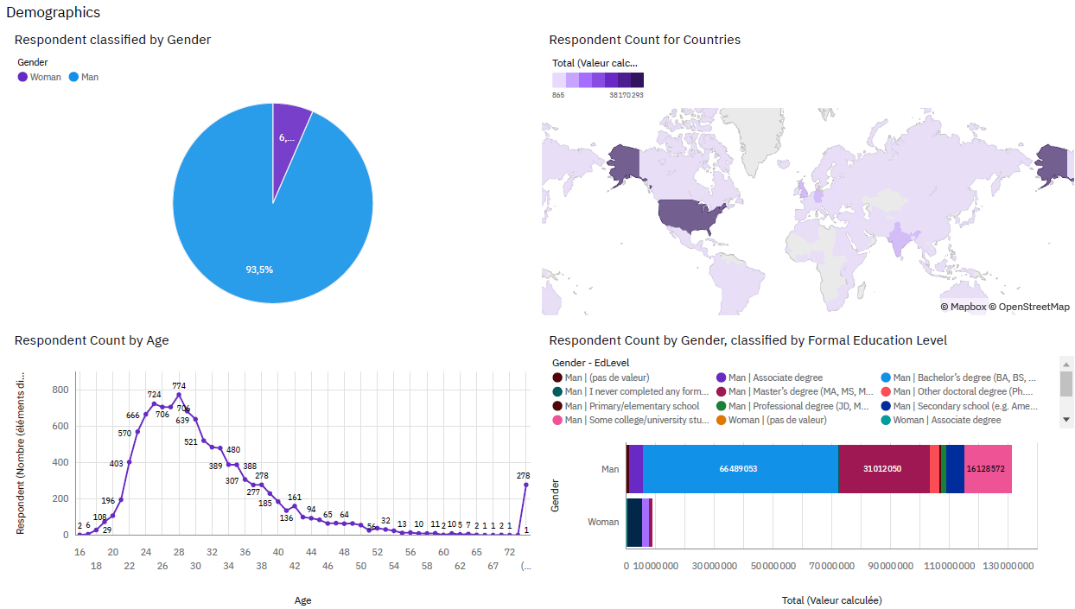
DASHBOARD TAB 3

Slide 15
DISCUSSION
Discussion Points:
Gender Gap: Addressing the gender imbalance as 93.5% of respondents are male.
Education Level: Evaluating if a bachelor's degree is sufficient since most respondents have it as their highest degree.
Global Tech Knowledge: Expanding tech knowledge and skills to developing countries to reduce the divide between the US and the rest of the world.
Mobile Technology: With mobile technology growing, languages like Kotlin are becoming more desirable.
Age Diversity: Encouraging older individuals to engage with tech trends, given the average respondent age of 28 years.
Tech Lexicon: Ensuring continued relevance of terms like Linux, Windows, AWS, and Docker in the developer field.

Slide 16
OVERALL FINDINGS & IMPLICATIONS
Summary of Findings:
Sales Trends:
Increasing Sales: Monthly sales are rising steadily.
Key Metrics: Total revenue, average order value, and transactions are improving.
Regional Sales Variations:
Differences in Sales: Significant regional differences, with some regions consistently outperforming others.
Customer Demographics:
Spending Patterns: Clear patterns linked to specific age groups, providing insights into customer behavior and preferences.
Developer Field:
Education and Age: Most developers have a bachelor's degree and are under 40, with the average age being 28.
Popular Programs: JavaScript and HTML/CSS are the most popular web development programs.
Demographics: Highest number of respondents from the United States, majority male.
Desired Skills for Next Year: JavaScript (language), PostgreSQL (database), Linux (platform), and React.js (web framework) are the most desired to learn.

Slide 17
OVERALL FINDINGS & IMPLICATIONS
Summary of Implications:
Focus on High-Performing Regions:
Allocate more resources to top regions.
Implement targeted marketing campaigns.
Tailor to Key Demographics:
Customize products and services for high-spending age groups.
Develop personalized marketing strategies.
Adjust Sales Strategies:
Monitor trends and make necessary adjustments.
Address underperforming areas with corrective actions.
Access to Skills in Developing Countries:
Enhance access to learning and development opportunities in less developed countries.
Web Development Skills:
Recognize web development as a highly coveted skill.
Data Professionals:
Ensure data professionals are proficient in NoSQL as well as SQL.
Importance of Python:
Continue to prioritize Python due to its significance in AI and ML.

Slide 18
CONCLUSION
The analysis highlights critical trends and implications in the developer sector:
Key Findings:
Sales Trends: Steady monthly sales growth with regional variations.
Demographics: Majority of developers are young, male, and hold a bachelor’s degree.
Popular Skills: JavaScript and HTML/CSS lead in web development; Python, PostgreSQL, Linux, and React.js are highly desired.
Implications:
Regional Focus: Allocate resources to high-performing regions and tailor marketing strategies.
Demographic Targeting: Customize products and marketing for key age groups.
Skill Development: Enhance access to learning in developing countries; prioritize web development, SQL, NoSQL, and Python skills.
Aligning strategies with these insights will help organizations stay competitive and innovative in the evolving tech landscape.

Slide 19
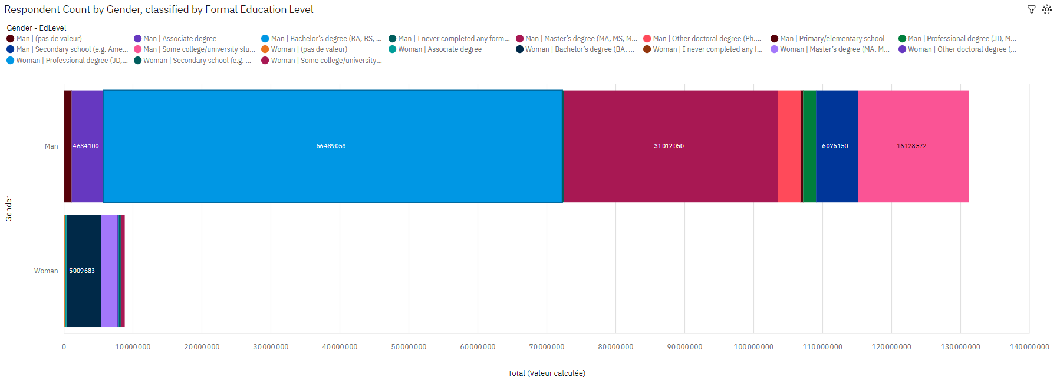
APPENDIX
The analysis reveals a significant gender imbalance in the developer field, with predominantly male respondents. Most respondents, both male and female, hold a bachelor’s degree, with notable numbers also holding master’s degrees.
This indicates the importance of higher education in the industry. To address these findings, efforts should focus on encouraging more women to enter and thrive in tech.
Additionally, enhancing undergraduate and advanced education programs can further support skill development in the field.

Slide 20
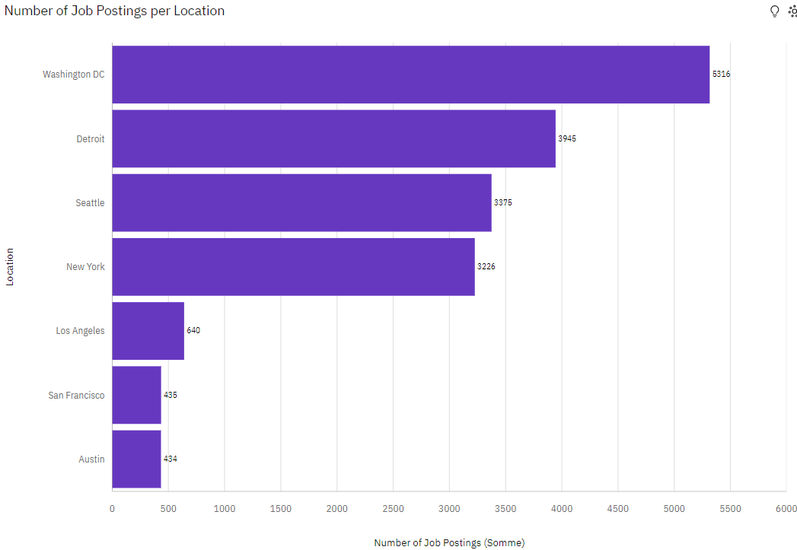
JOB POSTINGS
Washington DC, Detroit, Seattle, and New York are the top locations for tech job opportunities, suggesting these cities are significant centers for tech employment.
Los Angeles, San Francisco, and Austin also present good opportunities but to a lesser extent.
This data can help job seekers target their job search and relocation efforts, and guide companies in strategic hiring and resource allocation.

Slide 21
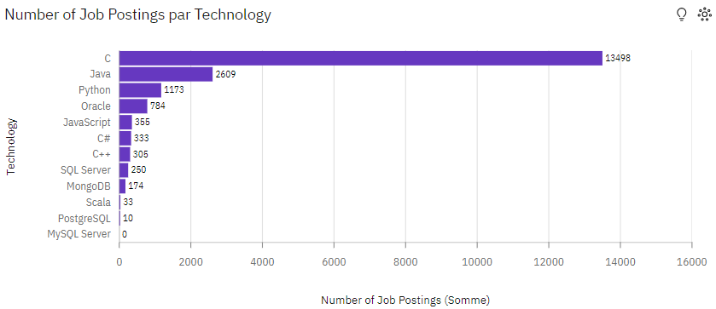
POPULAR LANGUAGES
The graph highlights a strong demand for skills in C, Java, and Python, with significant job opportunities in these areas.
Oracle and JavaScript also show notable demand, while technologies like MongoDB and Scala have more niche markets.
Despite PostgreSQL and MySQL Server's lower job posting numbers, they remain important in specific contexts. This data can guide professionals in focusing their skill development to align with market demands.

